Slide 1


Citation Pollution & Predatory/Questionable Publishing Practices
DIGI-FACE Publications Webinar
29 February 2024
Wynand van der Walt
  Senior Manager: Innovation, Systems and Collections (Rhodes University)
  Director: KAIMSAfrica

Slide 2
Abstract
The session provides background on citation pollution and its effect on scholarly integrity and reputation. It is intended to provide the academic and academic library community with an understanding of how to further engage with their respective decision-makers and policymakers on distinguishing between questionable and legitimate science and the tools currently available to assist with this process. The importance of dealing with illegitimate research on time, both from scholarly communication and research quality perspective, is emphasised.
Rhodes University/ Department / Unit / Document / Date

Slide 3
Critical Questions
What is your reputation as a scholar worth to you?
What is your institutional scholarly reputation worth?
As a publisher or editor, what is your reputation worth?
What is our role in reputational risk management?
How do we support scholarly rigour as researchers, librarians and research support units?

Slide 4
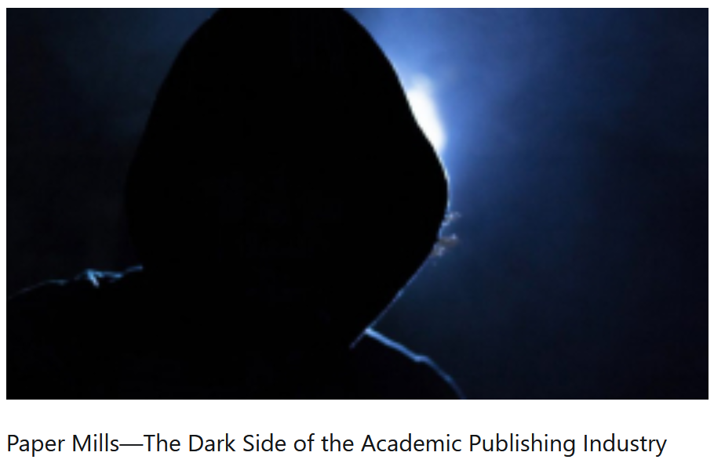
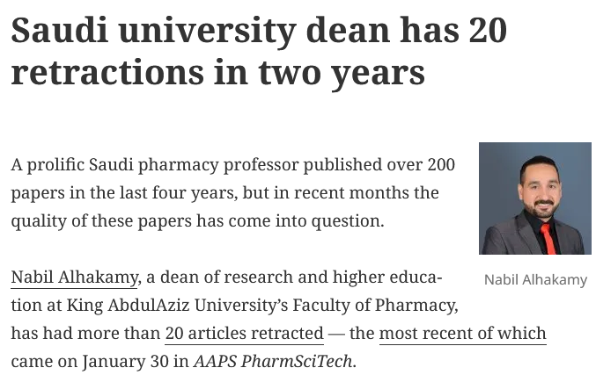
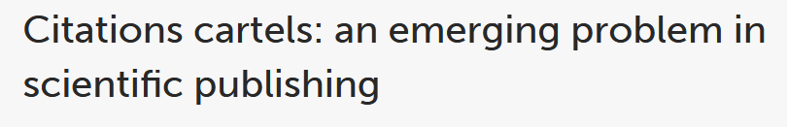
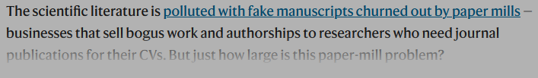
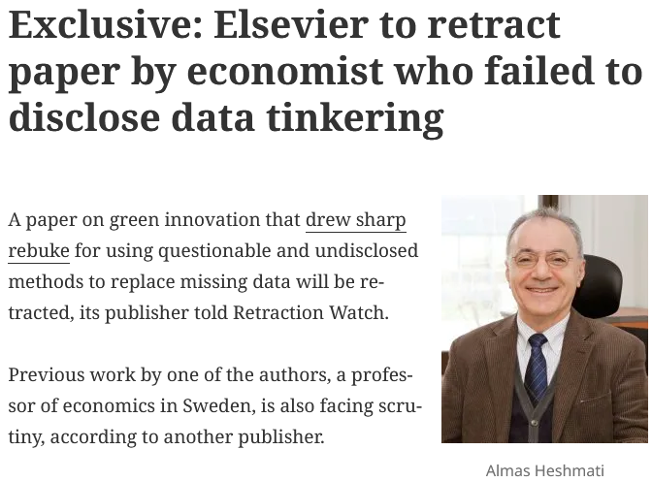
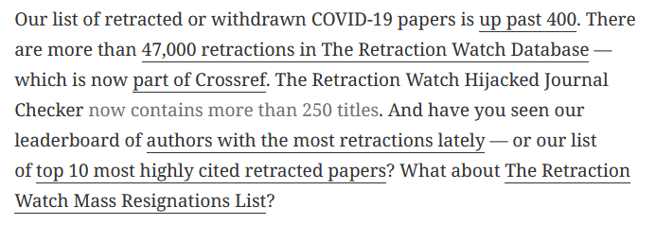
A look at science today

Slide 5
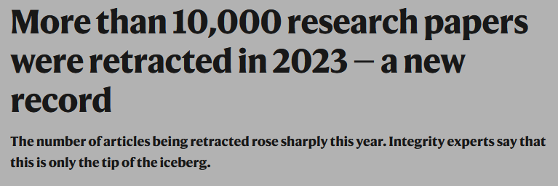
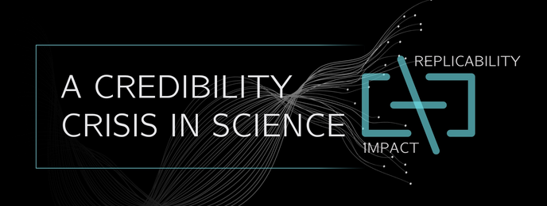
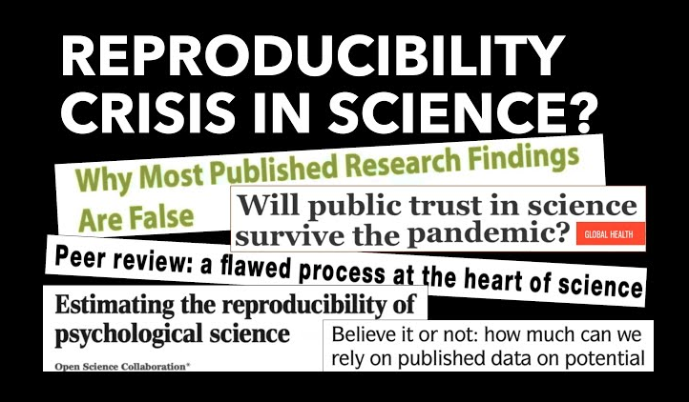
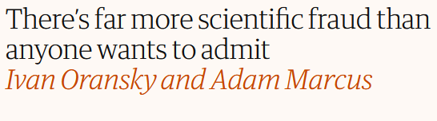

Slide 6

What will I address today
What is the difference between questionable and legitimate science?
What is citation pollution?
How does it effect scholarly integrity and scholarly reputations?
What can the academic library community do?
Which tools are currently available to assist?
Rhodes University/ Department / Unit / Document / Date

Slide 7
Questionable versus Legitimate Science

Slide 8
Questionable versus Legitimate Science
Questionable Science
  Do not adhere to best practices regarding scholarly integrity
  Invalidated science due to unethical behaviour in research
  Types of questionable science:
    Articles published in predatory journals
    Retracted Research
    Unidentified “Bad” Science
    Weak or Low-Quality Science
    Falsified Science
    Other unethical behaviours, e.g. lack of RDM?

Slide 9
Questionable versus Legitimate Science
Legitimate Science
  Adheres to best scholarly practices
    Researcher level
    Institutional level (e.g. ethical clearance)
    Publisher level
    Editorial processes level

Slide 10
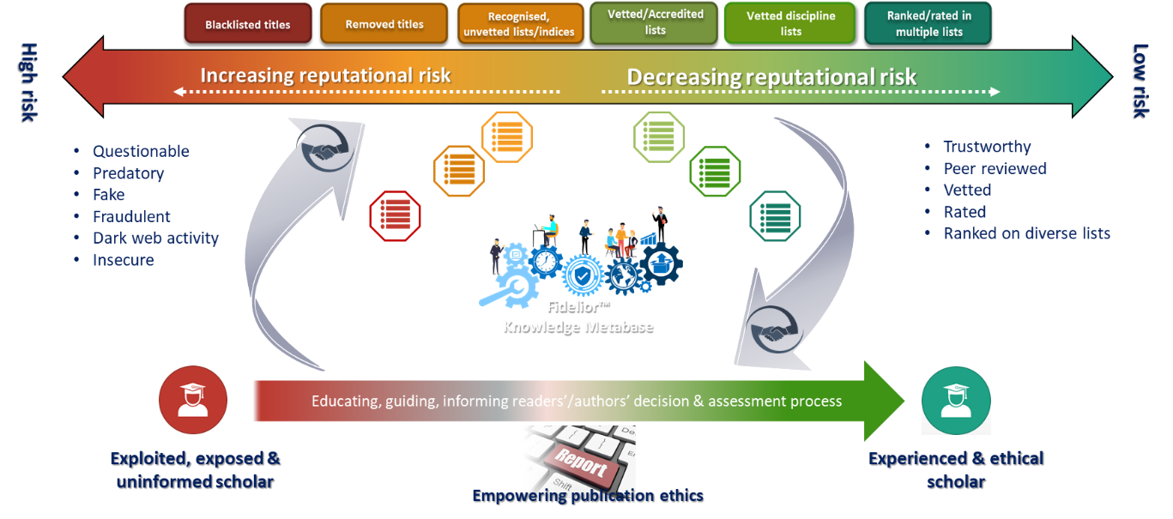
Best versus Bad Practices
How to distinguish
  Journal vetting & Reputational Risk [2]

Slide 11
Citation Pollution

Slide 12
Citation Pollution
Citation Pollution results from citation behaviours where scholars knowingly or unknowingly cite low-quality or pseudoscientific materials as part of their scholarly creation and communication processes and how these scholarly outputs are disseminated within the scholarly ecosystem.
“Entire fields of scientific research are now [be] susceptible to a pollution of the literature by unverified research or even fake articles published in fake journals being incorporated into legitimate meta-analyses.”[3]

Slide 13
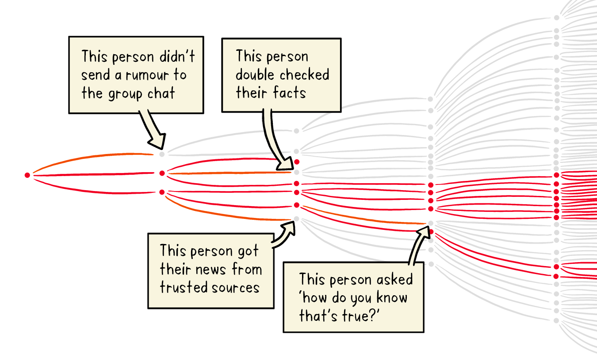
WHO – ‘Let’s flatten the infodemic curve’
(https://www.who.int/news-room/spotlight/let-s-flatten-the-infodemic-curve)

Slide 14
Impact of Citation Pollution
It can corrupt academic evaluation systems.
Researchers, knowingly or unknowingly, build their academic reputations based on questionable publications and pseudoscience.
Scholars receive recognition, are promoted and remunerated based on articles published in questionable outlets.
Predatory journals can be used to inflate a researcher’s Google Scholar citation metrics and H-index.
Accreditation bodies are influenced and misled.

Slide 15
Impact of Citation Pollution
Questionable science can damage the professional standing, ranking, and reputation of universities.
Questionable science can distort public discourse.
Questionable science and citation pollution can lead to the wastage of resources.
Questionable science can lead to retraction or discontinuance of funding opportunities for research entities and/or researchers.

Slide 16
Journal Assessment & Due Diligence

Slide 17
Identifying Reputable Journals
Journal list types
  Audit 2020
    400+
    So-called “Journal Blacklists”
      Stop Predatory Journals
      Cabell’s
      Beall’s
      Iranian Journal Blacklist
      Malaysian Blacklist
    Vetted / accredited / approved
      Indices (indexing & abstracting services)
      Organisational vetted
      Institutional vetted
      Research entity vetted
      Directories

Slide 18
Journal Assessment
Assessment Practices
Scientific rigor ^{[15]}
  Peer-review
Affiliations
  Organisations
Editorial Board
  Affiliation of Board members
Impact Factor
Business Model
Indexing is expression of assessment
Scholarly Ecosystem

Slide 19
Journal Reputation and Standing
Are you able to find the journal title easily using a web browser and search engine?
Is it easy to find the latest issue and articles published in the journal?
Does the journal have a long-standing reputation and has the journal been publishing regularly over a period of time?
Does the journal provide information about its previous name changes, if applicable?
Does the journal claim a valid and verifiable impact factor?
Does the journal use internationally accepted metrics?
Does the journal have an ISSN and/or e-ISSN?
Do articles in the journal have Digital Object Identifiers (DOIs)?

Slide 20
Journal affiliation
Is the journal published by, associated with or affiliated to a reputable organisation (e.g., academic societies)?
Is the journal endorsed by a reputable organisation?
Is the journal or journal publisher a member of the Committee on Publication and Ethics (COPE), Open Access Scholarly Publishers Association (OASPA), European Association of Science Publishers (EASE) and/or listed in the Directory of Open Access Journals (DOAJ)?

Slide 21
Peer review policy & processes
Does the journal require a peer review as part of the publication process?
Has the journal got a clear and well-defined peer review policy?
Is the peer review process informative and apparent?
What type of peer-review process is followed? Does the journal follow a double-blind peer-review process?
How many reviewers are typically used during peer review?
How long does the peer review process typically take? Is this timeline reasonable given disciplinary or industry standards?
What is the journal’s acceptance rate? (Journals with lower article acceptance rates are typically regarded as more prestigious.)

Slide 22
Editorial boards
Does the journal have an editorial board, and are the members of the board clearly stated?
Do the editors belong to editorial forums e.g., the World Association of Medical Editors (WAME)?
Do the editors state on their websites or professional social networking platforms that they are the editors of the journal in question? (Editorial boards may be highjacked.)
Are the editors associated with reputable organisations locally or internationally?
Are the editors experts in their respective disciplines?

Slide 23
Journal Assessment
Vetting Principles
Compliance to set of criteria ^{[15]}
  Principle of transparency and best practice^{[9]}
    Editorial Forums e.g. WAME
    Membership e.g. OASPA, COPE
  Journal review processes
    Policy statement (ethics, etc.)
    Technical
    Administrative (publication regularity, identifiers, etc.)
Reliance on renowned index providers
  e.g. Clarivate Analytics, Elsevier, etc.
Scholarly Ecosystem

Slide 24
Publication processes
Are the publication timelines realistic and indicative of rigorous peer review?
Is the journal associated with a reputable publisher?
Do the publisher require you to submit the research dataset?

Slide 25
Publication processes
What business model (e.g. Open, Hybrid or Closed access) does the journal follow? If it is an Open Access journal:
  Is the Open Access (OA) model clearly stated?
  Does it charge Article Processing Charges (APCs)? If it charges APCs, are they realistic?
  Does the publisher consider waivers or discounts on the APCs? (This practice is helpful for researchers from emerging economies.)
  Is there a withdrawal or admin fee if authors wish to retract their submissions?
  If a withdrawal or admin fee for retractions exists, are there any conditions applied by the publisher? Do you retain copyright when you retract a paper?

Slide 26
Publication processes
Does the author retain copyright during the submission process? (Preferably an author should retain copyright.)
Does the author retain the copyright of the work once published? (Generally, if the journal is open access, authors retain their copyright.)
Does the author have to sign a publisher’s agreement?

Slide 27
DHET & Journal Vetting [1]
“… DHET trusts international lists to exercise sufficient internal quality checks to ensure that the journals included in their lists comply with the highest standards of editorial quality and integrity.”
“However, it is now well documented … that international journal indexes and lists do not in fact exercise sufficient quality controls”

Slide 28

Bad practices

Slide 29

Best practices

Slide 30
Academics and Academic Librarians
Reflect on Citation Behaviours and Patterns
Reflect on Scholarly Support rendered to the scholarly community
  What is meant by a Scholarly Librarian post or unit?
  What is meant by a Digital Scholarship post or unit?

Slide 31
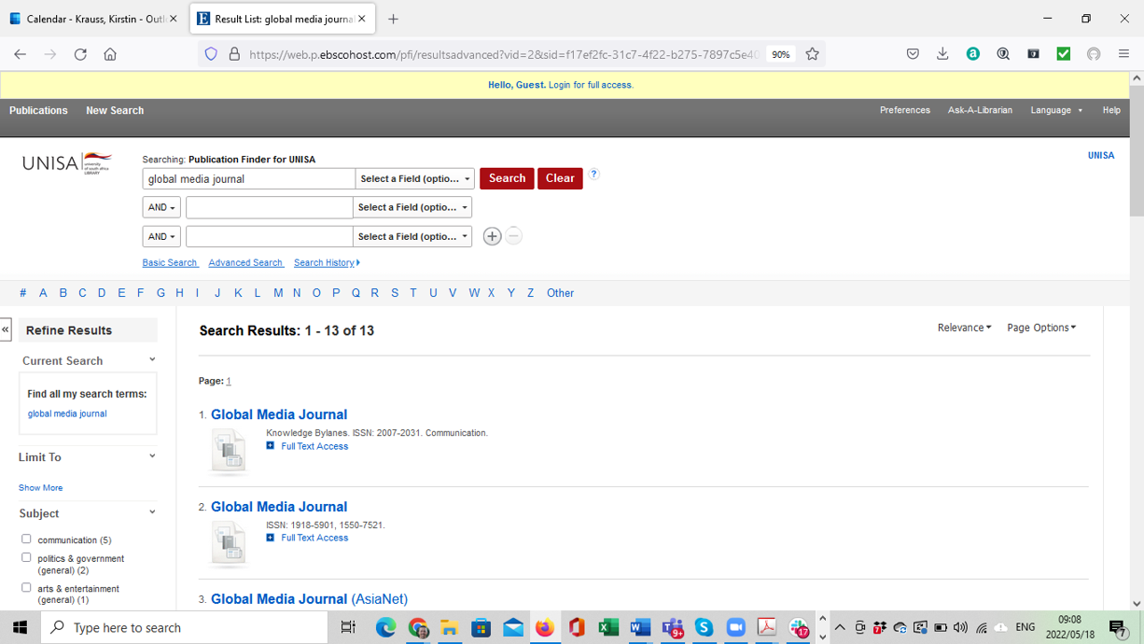
Academic Librarians & Citation Pollution
Reflect on possible actions that can be taken:
  Which journals are being made accessible at your library?

Slide 32
Academic Librarians & Citation Pollution
Reflect on possible actions that can be taken:
  Which journals are being made accessible at your library?
  How do you support emerging and established scholars with citation behaviours?
    Understanding why researchers cite what they cite
    Referencing and referencing tools
    Consider checking reference lists on their behalf
    Look at articles preferably pre-publication
    Follow due diligence process on their behalf

Slide 33
Academic Librarians & Citation Pollution
Reflect on possible actions that can be taken:
  Which journals are being made accessible at your library?
  How do you support emerging and established scholars with citation behaviours?
  How do you support publishing initiatives within your institution?
    Is the Library involved?
    Quality of metadata on publishing platforms?

Slide 34
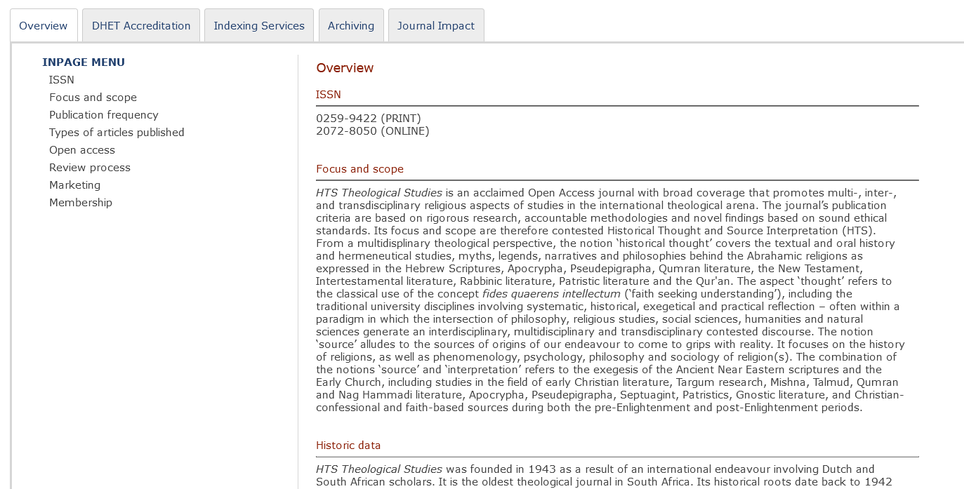
Quality metadata

Slide 35
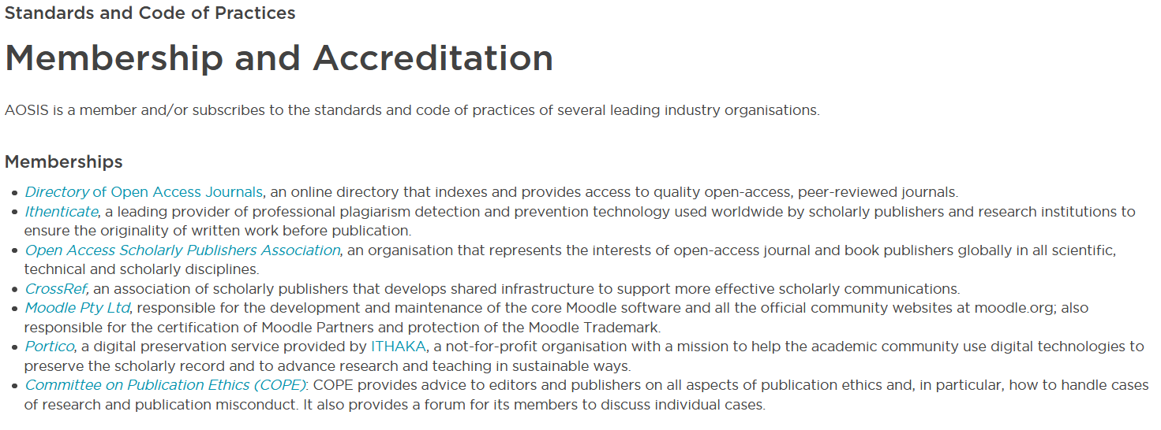
Quality metadata

Slide 36
Way forward: Responsible partnering
Collaboratively we have to take quality assurance to a new level

Slide 37
Scholarly innovative ecosystem
4. Toolbox
Environment, Services, Software solution, Knowledge Sharing Interventions, …
3. Community
Co-creative collaboration & networking in knowledge economy
2. Opportunity
Overcoming barriers challenging scholarly integrity while furthering science
5. Return Of Investment
Academic Integrity, Trusted Research environment,
Sustainable Partnerships…
6. Meaningful Transformation
Transformation of the Scholarly Communications landscape, Societal Impact.
1. Stakeholders
Scholars; Research Institutions; Public; Private sector

Slide 38
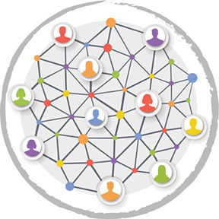
Way forward

Slide 39
Publishers Action List
Engage with all stakeholders:
  Publishers and journal hosts:
    To ensure journal titles are unique
    To ensure identifiers have been registered
    To check their data:
      For correctness
      For completeness
      For openness
      On all platforms including catalogues, journal lists, ISSN Portal, Wikidata, Wikipedia, Ulrichs, aggregator lists, indices, knowledgebase providers, etc.
    When changing titles, please also change ISSN
    Register for DOI at journal title level and use this as the persistent ID
    When articles are retracted, do NOT delete objects as this adds to link-rot
    To ensure that bibliographic-level metadata is part of “open science movement”

Slide 40
Publishers Action List
Engage with all stakeholders:
  List compilers and owners:
    To check their data:
      For correctness
      For completeness
    To provide clear set of criteria for reasons for inclusion and exclusion
    To use standard format for expressing reasons
    To not just change titles on lists where the journal title has changed, but rather create new bibliographic entry
    Provide status of journal, example of “C” status:
      Current
      CKA (Currently Known As)
      Ceased

Slide 41
Publishers Action List
Engage with all stakeholders:
  Academics / Researchers:
    Triple check references as human error is evident and impacts on:
      Increase in citation pollution
      Inability or difficulty to assess impact of article
      Inability or difficulty to cross-link between disparate systems
    Include persistent identifiers in all references
    Scholarly due diligence

Slide 42
Scholarly Due Diligence

Slide 43
Good things coming from the Covid-19 race
The scientific community is doing better at correcting itself
Post-publication reviews are flourishing - An emerging awareness and accountability within the scholarly community led to critical retractions, withdrawals, and corrections
Cleaning up literature may be a more difficult task:
  The need for proper retraction notices with clear reasons – Google Scholar can flag retractions earlier
  Avoiding “link rot” or “reference rot”
Many of the retractions occurred after the publication
“this highlights the urgent need to “clean up the references” and update research to remove or revisit claims that are based on retracted research. If not, inferior or flawed research will continue to permeate through science”
Speed is the enemy of rigorous science

Slide 44
Conclusion
Why do I cite the research I cite, and can I trust them?
Who do I trust to partner with in publishing my research?
Can other researchers trust me?

Slide 45
References
[1] Mouton, Johan. 2021. Research Quality Framework for scholarly outputs in SA
[2] Fidelior. 2021. Doing Due Diligence with FideliorTM (Current draft internal document)
^{[3]} Roberts, J. 2016. Predatory journals: illegitimate publishing and its threat to all readers and authors. Journal of Sexual Medicine, vol. 13, n° 12, p. 1830-1833

Slide 46

Thank you / Nkosi / Dankie

